Slide 1



Leveraging BCG MATRIX
for Game Portfolio Management
Notes:
More enticing title

Slide 2




Founded in 2008
Diverse range of games
Notes:
Arcane Studios is a leading game development company known for its innovative And immersive gaming experiences. Founded in 2008, the studio has gained a reputation for pushing the boundaries of storytelling, gameplay mechanics, and graphics. Arcane Studios' portfolio includes a diverse range of games, from epic fantasy RPGs to cutting-edge sci-fi shooters.

Slide 3

Gaming Industry
3B+ sales globally and a 1043% positive change of Global Sales from the beginning to the year 2016. With an average 279% improvement per decade.
Notes:
The gaming industry has experienced exponential growth, with global sales exceeding 3 billion dollars. From its inception to 2016, there was a remarkable 1043% positive change in sales, averaging a 279% improvement per decade. This data underscores the industry's transformative evolution into a global entertainment powerhouse

Slide 4
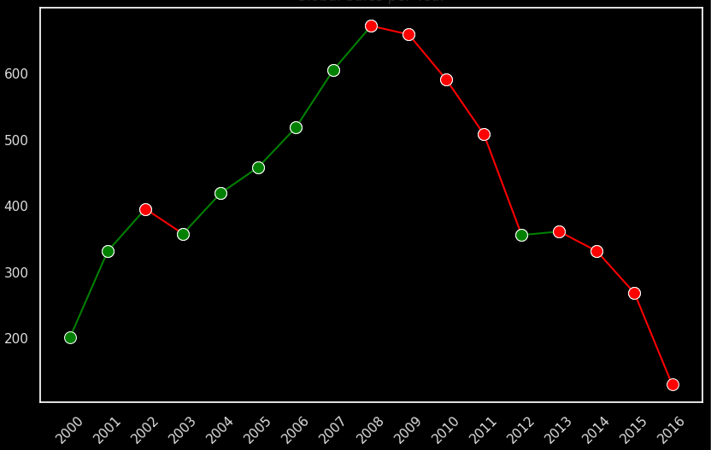
Global Sales Per Year
Total Global Sales
Year
Notes:
Data Context: From the Total Sales per year it is above a hundred million mark and this just shows the potential in sales for video games industry. But why is there a downtrend? (Next Slide)

Slide 5
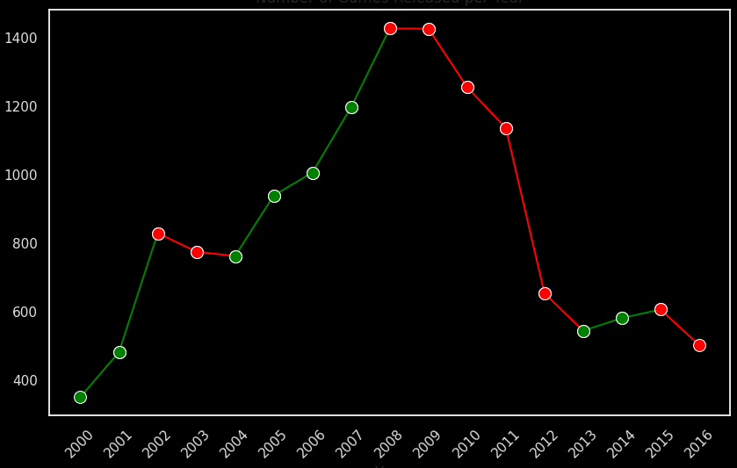
Count of Released Games Per Year
Count of Released Games
Year
Notes:
Data Context: There is a drop in count of games released with the same timeline of the Global Sales dropped. This pertains that the number of count of games released has an impact with the global sales.

Slide 6
Total Global Sales Per Genre
Action 1.53K (21.32%)
Role- Playing 0.73K (10.21%)
Misc. 0.72K (10.04%)
Sports 1.13K (15.8%)
Racing 0.56K (7.83%)
Simula
Tion 0.34K (4.68%)
Fighting 0.31K (4.35%)
Shooter 0.91K (12.75%)
Platform 0.49K (6.91%)
Adventure 0.18K (2.57%)
Strategy
0.12K (1.61%)
Puzzle 0.14K (1.94%)
Notes:
Context: Now this graph shows the Genre distribution of sales from 2000 to 2016. But just because they have the highest sales does not mean that the Arcane Studios should focus with this. With this we will be introducing to you our strategy of leveraging the Genre’s sales data to categorize their profitabilit

Slide 7
What are the Plans of Arcane Studios?
Data-driven game development by sales, performance metrics, user feedback etc.
Maximize player engagement, retention, and overall gaming experience

Slide 8




Why BCG Matrix?
Market Share
Growth Rate
Notes:
We've chosen to use the BCG Matrix because it's suitable for managing Arcane Studios' diverse game portfolio. It helps us figure out how each game genre is doing in the market and decide where to put our resources.
Now, about the BCG Matrix: It sorts our game genre into four groups - Stars, Cash Cows, Question Marks, and Dogs. It looks at two things: how fast the game is growing and how much of the market it has. Stars are growing fast and have a big market. Cash Cows are stable and popular. Question Marks have potential but not many players yet, and Dogs aren't doing well in both areas. In the case of Arcane Studios, they find themselves in the 'Question Mark' category. This means they have potential but not many players yet, and it's a point of intrigue for us.
This tool helps us plan what to do with each game, with the ultimate goal of propelling Arcane Studios into STAR category. Now, I’d like to transition to our next speaker, who will show us how we're using the BCG Matrix to make decisions about our games and player experience.
"Star" as a rising superstar in the business world.
"Question Marks" as the curious kids in school who might become something great or might face challenges.
Companies milk these Cash Cows for profits to support other ventures.
Dogs: These are low-potential products or businesses that don't require much attention. They may be kept around but are unlikely to become big successes.

Slide 9
BCG Matrix - Introduction
Market Share
STARS
Global sales
Growth in player engagement and retention
QUESTION MARKS
Global sales
Low player scores
Growth Rate
CASH COWS
Stable or declining sales
Substantial player base
DOGS
Market Penetration
Player engagement
Notes:
Introduction can be shorten
BCG MATRIX is a strategic business framework that classifies a company's products or services into four categories: Stars, Cash Cows, Question Marks, and Dogs. These categories are based on the product's market growth rate and relative market share. "Stars" represent products with high growth potential and a strong market position, "Cash Cows" are established products with high market share and stable growth, "Question Marks" are products with high growth potential but low market share, and "Dogs" are products with low market share and low growth prospects. The BCG Matrix helps organizations allocate resources and make strategic decisions based on the performance and potential of their product portfolio.

Slide 10
BCG Matrix - Introduction
Market Share
STARS
Global sales
Growth in player engagement and retention
QUESTION MARKS
Global sales
Low player scores
Growth Rate
CASH COWS
Stable or declining sales
Substantial player base
DOGS
Market Penetration
Player engagement

Slide 11
BCG Matrix - Introduction
Market Share
STARS
Global sales
Growth in player engagement and retention
QUESTION MARKS
Global sales
Low player scores
Growth Rate
CASH COWS
Stable or declining sales
Substantial player base
DOGS
Market Penetration
Player engagement

Slide 12
BCG Matrix - Introduction
Market Share
STARS
Global sales
Growth in player engagement and retention
QUESTION MARKS
Global sales
Low player scores
Growth Rate
CASH COWS
Stable or declining sales
Substantial player base
DOGS
Market Penetration
Player engagement

Slide 13
Where Arcane stands?
Market Share
STARS
Global sales
Growth in player engagement and retention
QUESTION MARKS
Global sales
Low player scores
Growth Rate
CASH COWS
Stable or declining sales
Substantial player base
DOGS
Market Penetration
Player engagement

Slide 14
Where they want to be
Market Share
STARS
Global sales
Growth in player engagement and retention
QUESTION MARKS
Global sales
Low player scores
Growth Rate
CASH COWS
Stable or declining sales
Substantial player base
DOGS
Market Penetration
Player engagement
Notes:
Introduction can be shorten
BCG MATRIX is a strategic business framework that classifies a company's products or services into four categories: Stars, Cash Cows, Question Marks, and Dogs. These categories are based on the product's market growth rate and relative market share. "Stars" represent products with high growth potential and a strong market position, "Cash Cows" are established products with high market share and stable growth, "Question Marks" are products with high growth potential but low market share, and "Dogs" are products with low market share and low growth prospects. The BCG Matrix helps organizations allocate resources and make strategic decisions based on the performance and potential of their product portfolio.

Slide 15
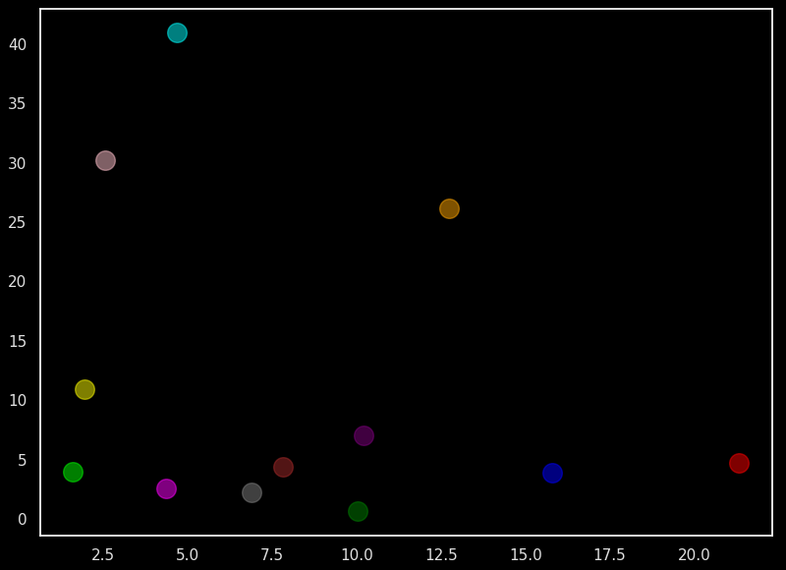
Genre classification
40
Growth Rate
35
① Total Sales by Genre per Year
② Percentage Change by Genre per Year
③ Overall Average Percentage by Genre
30
25
20
15
Average Growth rate
10
5
0
2.5
5.0
7.5
10.0
12.5
15.0
17.5
20.0
Average Market share
(Total Sales per Genre/Total Sales of all Genre)*100
Market Share

Slide 16



40
Simulation
35
30
Adventure
25
Shooter
Growth Rate
20
15
10
Puzzle
Role-playing
Racing
Sports
Action
5
Fighting
Strategy
Misc.
Platform
0
2.5
5.0
7.5
10.0
12.5
15.0
17.5
20.0
Market Share

Slide 17



Recommendation
Investment
Game events
and update
Increase sales
Notes:
We recommend a focused approach for our Stars category. Invest in game quality to maintain market leadership. Then create exciting in-game events and aggressive external promotion.
Together, these strategies can drive a 30% sales increase next fiscal year.
Let’s elevate Stars to new heights

Slide 18



40
Simulation
35
30
Adventure
25
Shooter
Growth Rate
20
15
10
Puzzle
Role-playing
Racing
Sports
Action
5
Fighting
Strategy
Misc.
Platform
0
2.5
5.0
7.5
10.0
12.5
15.0
17.5
20.0
Market Share
Notes:
Add arcane studios

Slide 19


Recommendation
Market share
increase
Make them STARS
Further research
Notes:
Increase market share by 5-10% for each question mark genre in the next two quarters.
Evaluate the revenue growth of “Question Mark” games over 6 mos. Determine the potential of “Question Marks” games for becoming Stars
➤ Conduct further research and experimentation to understand why adoption is low and develop strategies to promote these aspects effectively.
In the Question Mark category, aim to boost market share by 5%-10% within the next two quarters.
To achieve this goal, assess revenue growth over six months to gauge the potential for these games to become ‘Stars’.
Next, we need conduct thorough research and experimentation to understand to understand why adoption of these games is currently low
And develop effective promotion strategies.
This approach will unlock the potential of our ‘Question Mark’ games.

Slide 20




40
Simulation
35
30
Adventure
25
Shooter
Growth Rate
20
15
10
Puzzle
Role-playing
Racing
Sports
Action
5
Fighting
Strategy
Misc.
Platform
0
2.5
5.0
7.5
10.0
12.5
15.0
17.5
20.0
Market Share

Slide 21


Recommendation
Monetization
Improve player loyalty
Grow player base
Notes:
In our cash cows category, our goal is to not only maintain but further enhance the performance of these assets.
First, we aim to optimize monetization to achieve an increase in monthly revenue. This can be realized through implementation of targeted in-game events, promotions, or premium content updates.
By consistently offering enticing value to our players, we can bolster revenue streams
Improve player loyalty through new features and engaging events and Grow our player base by leveraging loyal players and subscription-based offerings.
Finally, we must remain vigilant in case new competitors enter our market. In such situations, we will prioritize marketing efforts to protect our market share and reinforce our position as the industry leader.
These strategies will maximize our returns and secure our dominance in this category.

Slide 22



40
Simulation
35
30
Adventure
25
Shooter
Growth Rate
20
15
10
Puzzle
Role-playing
Racing
Sports
Action
5
Fighting
Strategy
Misc.
Platform
0
2.5
5.0
7.5
10.0
12.5
15.0
17.5
20.0
Market Share

Slide 23


Recommendation
Phase out
Redesign
Improve
Notes:
Our approach here involves a thorough evaluation of these products. We must assess whether it makes sense to phase them out, redesign, or invest resources to improve them, considering their long-term viability.
Consider divestment if a product isn't generating enough revenue or doesn't align with our strategic goals.
This approach ensures efficient resource allocation and long-term success.

Slide 24
Recommended Genre for Arcane Studios
40
Simulation
35
30
Adventure
25
Shooter
Growth Rate
20
15
10
Puzzle
Role-playing
Racing
Sports
Action
5
Fighting
Strategy
Misc.
Platform
0
2.5
5.0
7.5
10.0
12.5
15.0
17.5
20.0
Market Share
Notes:
After a thorough analysis of Arcane Studios' game portfolio, we have identified strategic recommendations for the genres to focus on.
Firstly, in the 'Shooter' genre, we have a 'Stars' category. This genre has shown rapid growth and has a substantial market share. It's an ideal opportunity for us to concentrate resources and further elevate our position.
Secondly, within the 'Sports' genre, we have identified opportunities within the 'Cash Cows' category. These games demonstrate stability and popularity. It's crucial to continue nurturing these titles, ensuring their long-term success.
Additionally, the 'Action' genre also falls into the 'Cash Cows' category. These games, like our 'Sports' titles, offer reliable returns. We recommend maintaining and enhancing these products to maximize revenue.
n conclusion, our strategic recommendations involve focusing on 'Stars' in the 'Shooter' genre, and continuing to nurture and develop 'Cash Cows' in both the 'Sports' and 'Action' genres. This approach will position Arcane Studios for continued growth and success.

Slide 25
Weak Sales and Scores correlation
1.0
1
0.25
0.088
Global Sales
0.8
0.25
1
0.58
0.6
Critic Score
0.4
0.088
0.58
1
User Score
0.2
Global Sales
Critic Score
User Score

Slide 26
GRANGER CAUSALITY MATRIX
Critic_Score & User_Score -> Sales
0.6
0.5
0.03
0.48
0.02
0.03
Critic Score
0.4
0.61
0.09
0.07
0.16
0.3
User Score
0.2
0.1
NA Sales
JP Sales
EU Sales
Global Sales

Slide 27

Sales vs Scores
TOP 5 USER SCORES (GENERAL WEIGHTED AVERAGE)
Adventure
Puzzle
Platform
Role-Playing
Action
7.98
7.96
7.76
7.56
7.48
Notes:
Summary of categorization in the matrix Refresher slides

Slide 28
Sales vs Scores
TOP 5 CRITIC SCORES (GENERAL WEIGHTED AVERAGE)
Strategy
Role-Playing
Sports
Shooter
Platform
76.19
75.56
75.39
74.27
72.95
Notes:
Summary of categorization in the matrix
Refresher slides

Slide 29

SUMMARY
The Games already have a positive Score from USER and CRITIC.
Arcane Studio should focus on other variables like MARKETING affecting SALES.

Slide 30
Recommendation for further studies
To have a more in depth business strategy, this business model can be used by replacing the Global Sales to a specific Region Sales to pinpoint which game is recommended to sell per region.
To know which platform to focus on selling games, an analysis of a game with multiple platform compatibility can be used to analyze which platform gives a better economic profitability.

Slide 31
Q & A
Notes:
Recommendation:
How specific recommendation with impact my decision?
Rationale
Know your audience

